Slide 1



Windows admin password recovery
Əli,
Əsəd,
Daniil
Səbinə

Slide 2


How many times have you forgotten a password in the last year? Losing a website password isn't a huge deal, because you can reset those with your email address. But forgetting your computer password is scary, because they're more difficult to reset.
If you've forgotten the password for a Windows administrator account, don't fear. There are several methods you can use to recover it. We'll show you how to reset administrator passwords in Windows, even if you don't have admin rights. While we focus on Windows 10 here, these tips should largely work the same in Windows 11 and other versions, too.

Slide 3


1. Reset the Windows Administrator Password With a Microsoft Account
One of the major benefits of using a Microsoft account with Windows is that you can reset your password by going through Microsoft's tools without much hassle.
First, make sure that you really can't access your Microsoft account (perhaps your keyboard has a stuck key or something similar). Go to login.live.com on your phone or another computer and try to sign in with the Microsoft account you use on your PC, making sure you don't mistype anything.
If you still can't get in here, then proceed with resetting your Microsoft password. Head to the Microsoft password reset page to get started, though you can also reset your password from the Windows login screen by clicking the I forgot my password link.
After confirming your identity with the details you've provided on your account, this page will walk you through resetting your Microsoft account password. Once that's done, use the new password to sign into your PC.
It's worth noting that if you have a Microsoft account, you should take a few minutes to update your security info on your Microsoft account page. Adding a phone number and secondary email address gives you options to reset your password easily; without them, it's much more of a hassle. A little bit of forethought now will make it much easier to reset your admin password in the future.

Slide 4



2. Reset a Local Windows Admin Password Using the Lock Screen Workaround
Reset a Local Windows Admin Password Using the Lock Screen Workaround
If you don't use a Microsoft account to log into Windows, you'll have to reset the password for a local account. Windows 10 and 11 allow you to set security questions for local accounts that help you get back in easily from the lock screen if you forget the password. If you haven't set those up already, however, they won't do you much good now.
If the locked account is the only administrator account on your PC, you'll need to first use a workaround to launch an elevated Command prompt. We walk through this process below.
Running a Command Prompt to Change Your Password
In previous versions of Windows, you could simply run the renamed shortcut to access a Command Prompt right from the login screen. However, Microsoft Defender now blocks these attempts, so there's an extra step required. If you're on an old version of Windows 10, or still using Windows 8 or earlier, you can press Shift five times on the login screen to open a Command Prompt.
On modern versions of Windows 10 or Windows 11, you'll have to reboot into Safe Mode for this to work. To do this, click the Power menu in the bottom-right corner of the login screen. Then, hold the Shift key and click Restart. If you see a warning that restarting may cause people to lose work, click Restart Anyway.
Then, you'll see the advanced settings menu. Click Troubleshoot > Advanced Options > Startup Settings, then Restart. Your PC will reboot, then ask which startup option you want to use. Hit the 4 key to select Enable Safe Mode. This loads Windows with only the essential drivers and services, preventing Microsoft Defender from blocking the workaround.

Slide 5
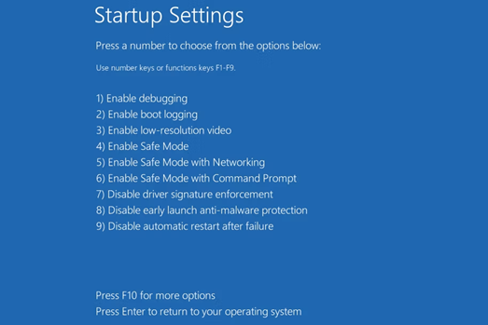
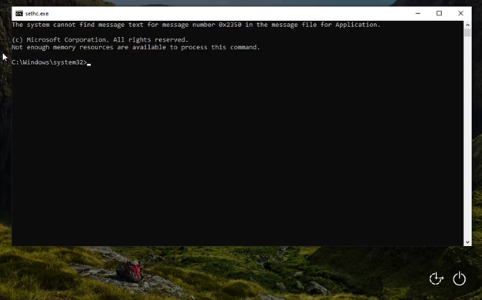

When you reboot to the Windows sign-in screen in Safe Mode, hit Shift five times quickly. This should bring up a Command Prompt, which has administrator access.
When you reboot to the Windows sign-in screen in Safe Mode, hit Shift five times quickly. This should bring up a Command Prompt, which has administrator access.
Now you can reset your account password, create a new account, or perform similar actions. To reset your account password, first, type net user to see all accounts on your machine.

Slide 6
Then, you can change the password for an account using the following command. Replace username and password with the actual username of your account and the new password you want to set, per the example after the template:
net user username password
net user John newpass123
Now, you've changed your account password and can log back in using it. Since you don't want to work in Safe Mode, reboot your computer and sign back in again as normal.

